Slide 1

Lakehead University
Department of Computer Science
Performance Comparison of Bins Approach with Deep Learning models for Image based Detection and Classification of Covid 19
Group No.25
By : Purva Shah
Dhruv Patel
Instructor : Dr. J. Fiaidhi

Slide 2
Content
Introduction
Literature
Problem Statement
Proposed Solution
Work Flow of the system
Algorithm with Implementation details
Experimental Set-Up
Data Set
Performance Evaluation Parameters
Results & Discussion
Conclusion
References
Publication

Slide 3
Introduction
The sudden spike in the number of patients with COVID-19, has put unprecedented load over healthcare systems across the world.
As we are currently experiencing uncertain waves of covid19 again and again and also Aiims director has said “That Covid as a disease might never go away.”.
It is thus important to differentiate which patients with Severe Acute Respiratory Illness (SARI) could have COVID-19 infection.
Hence, we propose the use of chest X-Ray to detect COVID-19 infection in the patients exhibiting symptoms of SARS.

Slide 4
Unlocking the Power of AI
“Unlocking the power of AI" refers to leveraging the capabilities of Artificial Intelligence to solve complex problems, improve efficiency and productivity, and drive innovation. AI has the potential to transform various industries such as healthcare, finance, transportation, and many others.
The performance comparison of Bins Approach with Deep Learning models for Image based Detection and Classification of COVID-19 would depend on various factors such as dataset quality, model architecture, training methodology, etc. However, generally, Deep Learning models tend to perform better in terms of accuracy and generalization compared to traditional computer vision techniques such as the Bins Approach.

Slide 5
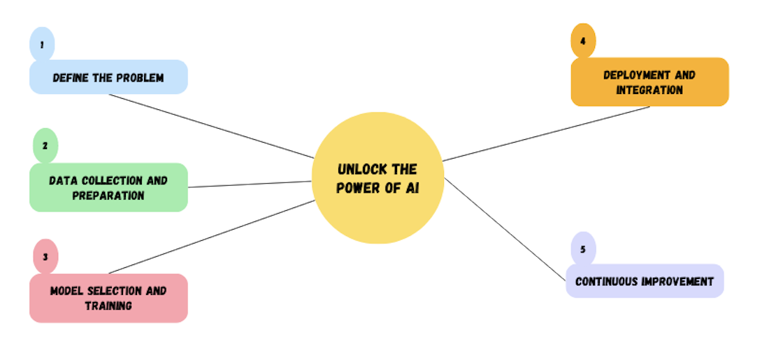
The steps for unlocking AI

Slide 6
Critical Review
Ref | Year | Introduction | Dataset Used | Methodology | Advantage | Disadvantages
[1] | May 2020 | A deep learning method that could extract COVID-19’s graphical features so as to give an analysis, a machine learning classification technique used to classify the Chest X-Ray images. | https://github.com/ieee8023/covid-chestxray-dataset | DCNN algorithm is executed with Tensor Flow and Inception V3. | DCNNs eliminate the need for manual feature extraction, one doesn’t need to select features required to classify the images. | CNN does not encode the position and orientation of the object into their predictions.
[2] | June 2020 | automatically detect the areas of interest in the chest X-ray, symptomatic of the COVID-19 disease. | COVID-19 image data collection(Available freely) | The method is aimed to mark as first step a chest X-ray as related to healthy or diseased. | VGG-16 has 92.7% test accuracy on ImageNet | VGG-16 It is very slow to train.

Slide 7
Ref | Year | Introduction | Dataset Used | Methodology | Advantage | Disadvantages
[3] | Aug 2020 | In this paper, CVDNet , Deep CNN model to classify COVID-19 infection from normal and other pneumonia cases using chest x-rays. | Dataset used- Kaggle’s COVID-19 radiography database | proposed a deep CNN model, as a tool for radiologists to automatically detect the infection. | The ResNet50 model is most widely used in image classification as it uses skip connections | ResNet may have its own limitations but, no other better model is available as of now.
[4] | April 2020 | COVID-Net as the baseline and comparing the results achieved in the proposed model with theirs | covid-chestxray-dataset for COVID-19 frontal-view chest X-Ray images | CovidAID, A PyTorch (python3) based implementation, to identify COVID-19 cases from X-Ray images. | CheXNet is a 121- layer CNN trained on ChestX-Ray14 | the labels are internally consistent, so systems trained on them seem to learn to reproduce
Critical Review

Slide 8
Ref | Year | Introduction | Dataset Used | Methodology | Advantage | Disadvantages
[5] | Sept 2020 | Paper explains different deep learning approaches for covid detection using X-ray images and compares it to the conventional pretrained models | the database is constructed using 180 Covid-19 examples and 200 normal healthy samples | three different deep learning approaches for covid detection | SVM on DCNN is slightly better than the results of neural network classification on DCNN extracted features | the size of the publicly available dataset is small
[6] | July 2020 | Initially convolutional layer is applied by using different masks to produce low level features. activation function used for this is ReLU | A COVID-19 X-ray image database was developed by Cohen JP. | Models used to compare svm, random forest, adaptive neuro fuzzy interface, back propogation network, cnn | Faster than real-time polymerase chain reaction. | the size of the publicly available dataset is small
Critical Review

Slide 9
Ref | Year | Introduction | Dataset Used | Methodology | Advantage | Disadvantages
[7] | June 2020 | proposed a Convolutional Neural Network model to automatically detect COVID patients. | Dataset consists of chest X-ray images of 341 COVID-19 patients obtained from GitHub Repository Shared by Dr. Joseph Cohen. | three different layers that are a convolutional layer, pooling layer, and fully connected layer are used to perform these operations effectively and different pre-trained models are used to find highest accuracy | There is no manual feature extraction,feature selection and classification in this method. | Transfer Learning utilizes a pre-trained neural network
Critical Review

Slide 10
Critical Review
The ResNet50 model is most widely used in image classification as it uses a technique called skip connections- skips training from a few layers and connects directly to the output. The myth is that adding more layers to a CNN will give us better results, but that is not the case, its performance suffers and it attains a low accuracy.[1]
Proposed a model architecture of pretrained CheXNet with a dense convolutional neural network(DenseNet) applied on frontal-view X-ray images for classification of covid-19,bacterial and viral pneumonia as well as normal lungs.[4]

Slide 11
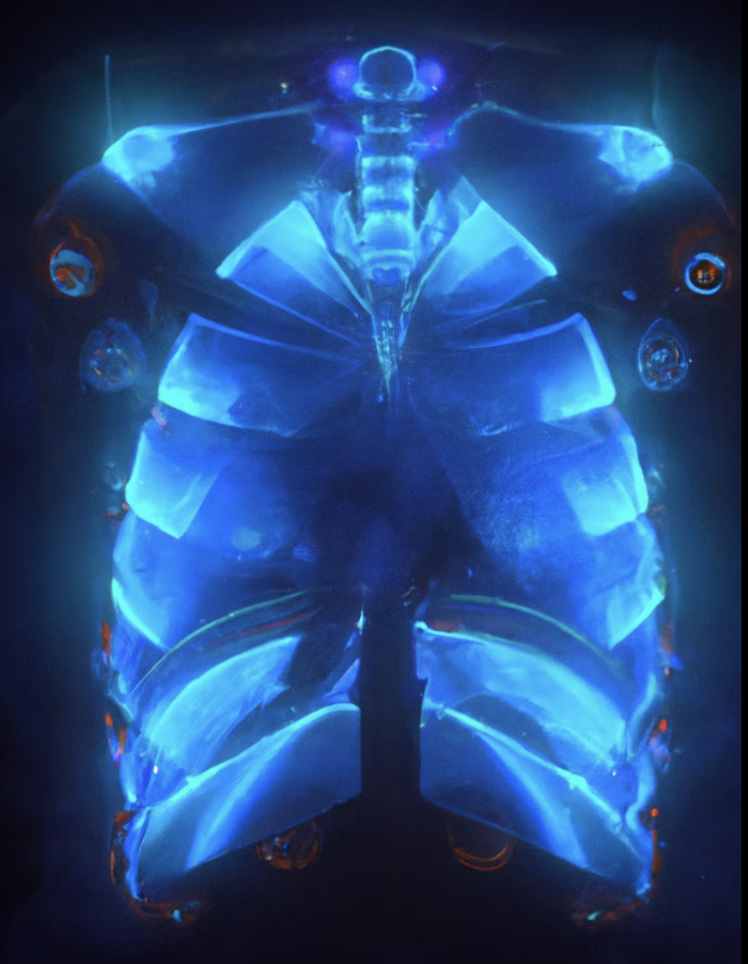
Problem Definition
“Develop a model that can accurately identify cases of COVID-19 based on chest X-ray images. The goal is to build a system that can accurately differentiate between normal and infected images, while also considering factors such as the diversity of X-ray appearances, the presence of other diseases that may cause similar symptoms, and the potential for false positive or false negative results.”

Slide 12
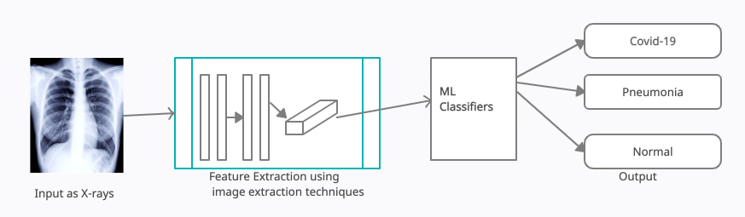
Workflow of the System
Our primary focus in this work is to prepare an automated system of detecting Covid19 using effective image processing and classifying them using machine learning techniques.
The fundamental aim of this system is to detect the white spot in the x-ray.

Slide 13
Algorithms to be used
ResNet-50, which was proposed in 2015 by researchers at Microsoft Research introduced a new architecture called Residual Network. In order to solve the problem of the vanishing/exploding gradient, this architecture introduced the concept called Residual Network.
For our model, we used a DenseNet121 pretrained model to create a CheXNet model. It has five convolution layers and employs average pooling.
Bins approach is a method of using image processing technique and ML Classification algorithms.

Slide 14
ResNet-50
ResNet-50, which was proposed in 2015 by researchers at Microsoft Research introduced a new architecture called Residual Network. In order to solve the problem of the vanishing/exploding gradient, this architecture introduced the concept called Residual Network.
In this network we use a technique called skip connections. The skip connection skips training from a few layers and connects directly to the output.
This network uses a 34-layer plain network architecture inspired by VGG-19 in which then the shortcut connection is added. These shortcut connections then convert the architecture into a residual network.

Slide 15
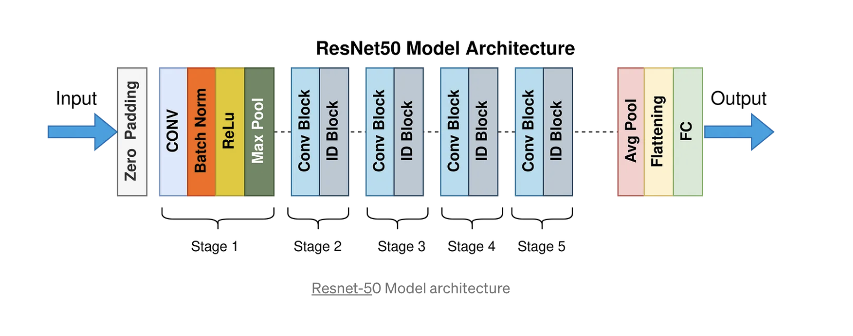
ResNet-50

Slide 16
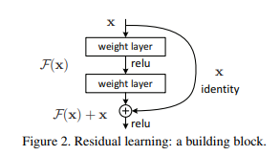
Why Resnet?
The requirement for a model like ResNet arose due to a number of pitfalls in modern network.
Difficulty in training deep neural networks
More expressive, less different:
Vanishing/Exploding Gradient
Skip Connections

Slide 17
CheXnet
For our model, we used a DenseNet121 pretrained model to create a CheXNet model. It has five convolution layers and employs average pooling.
We loaded the weights from the pretrained from the pre- trained model into our model using the weights file. Because this ChexNet model was trained on chest x-ray images itself as opposed to other models.
First, we load the dataset that contains 6432 images with 3 classes for binary classification. As the DenseNet takes input images of size 224x224, resize the images in our dataset to 224x224.Then take the DenseNet network with pretrained weights of CheXNet without including the full connected (FC) layer as head.

Slide 18
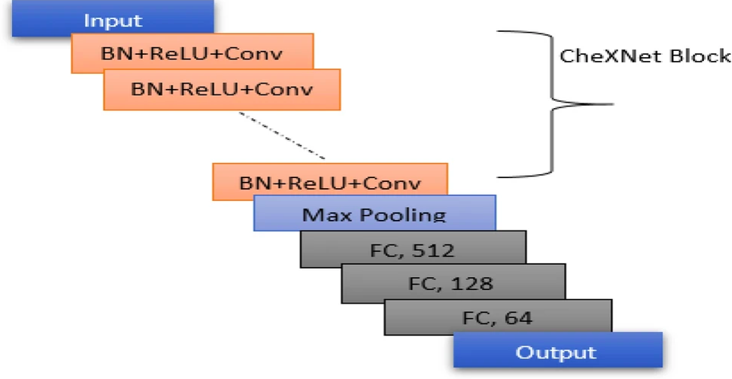
CheXnet Model Architecture
CheXnet

Slide 19
CheXnet 2.0
Things we think are probably true, but not convinced of:
That this system is superhuman. There are several minor issues with the statistical analysis and not enough doctors/data points for me to truly accept this claim given how close to 0 the confidence interval is.
The system learns to match good quality image labels despite the flawed training data. This is very interesting, but without seeing the results in the other classes it is hard to be sure that the pneumonia result is not an outlier. Even if it is true, there is no doubt in our mind that the performance would be better with cleaner training labels.
Things we personally prefer were different: (and will try to change):
Keep the ROC curve, add a few more metrics.
Do some sort of outlier analysis.
More doctors!

Slide 20
Bins Approach
The "bins approach" in machine learning is a way to transform continuous numerical data into categorical data by grouping values into discrete "bins" or intervals. This approach is often used when a machine learning algorithm requires categorical data, such as decision trees or random forests.
In this approach, the continuous numerical data is divided into several bins or intervals based on some criteria, such as equal width or equal frequency. The number and size of the bins depend on the range and distribution of the data. Each value is then replaced with the corresponding bin label, which becomes a categorical variable.

Slide 21
Classification of Covid-19 using Bins Approach:
Bins Approach is a novel technique that can extract essential image contents and represent in the form of simple feature vectors with a significant reduction in the feature dimensions. It is one of the Content-Based Image Retrieval (CBIR) processes that attempts at retrieving appropriate features from large digital image databases. It has proved its best performance in the CBIR domain. In order to check its performance in the medical field, we are proposing to apply the same for our malaria parasite detection system.
Steps :
Obtain histogram for each Image.
Divide the histogram into 8 bins of intervals(32 pixels) for each image.
Apply polynomial transformation y=2x- x² once each image.
Calculate for statistical moments such as mean, standard deviation, skewness, and kurtosis.
5. Store values obtained in their specific datasets and apply classification on each.
Bins Approach

Slide 22
Experimental Database
Type of Data: Gray Scale Images
Size of Single Image: 20kb - 4mb
Image Format : JPEG
Range of pixels: 0-255
Source:
Kaggle :
https://www.kaggle.com/bachrr/covid-chest-xray?select=images
2. GitHub:
ieee8023/covid-chestxray-dataset at 2d14801d77c316d88bac6d8855504c52aa12dc8c
https://sirm.org/2020/03/19/covid-19-caso-55/

Slide 23
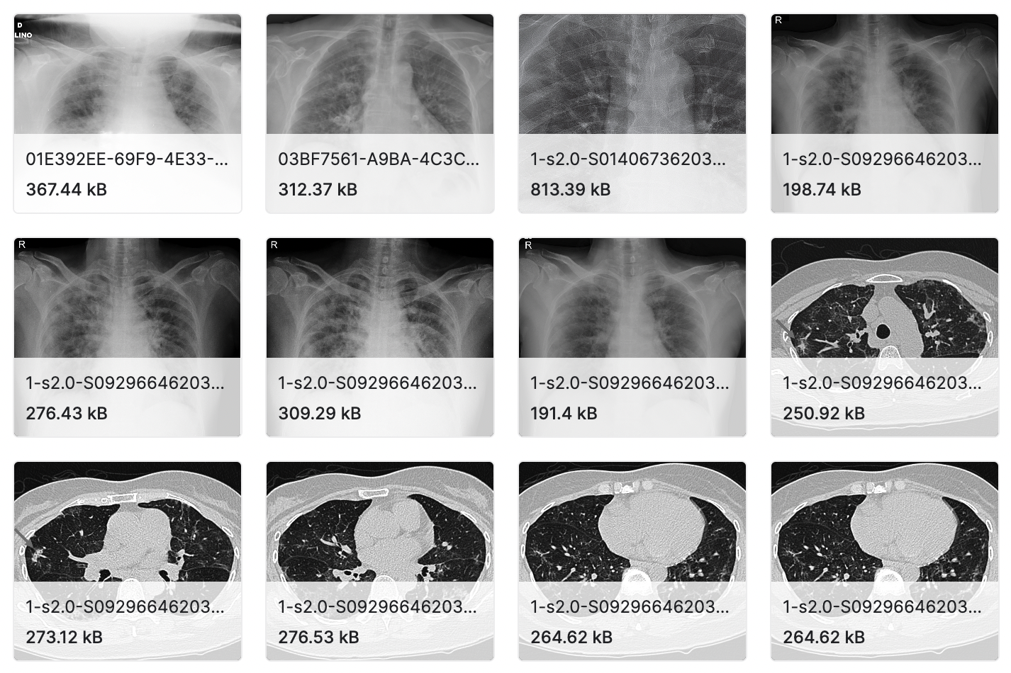
Experimental Database

Slide 24
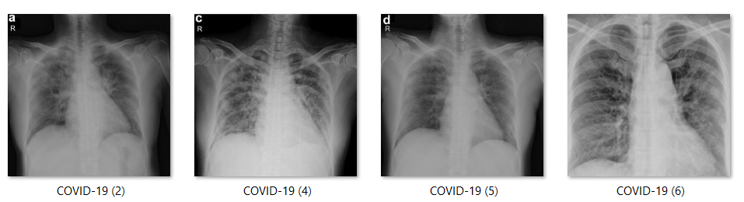
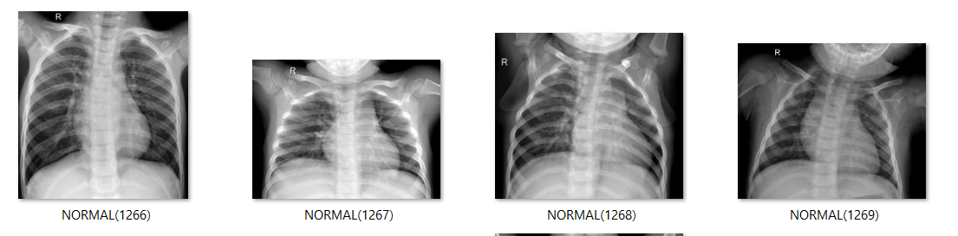
Experimental Database (Labeled)

Slide 25
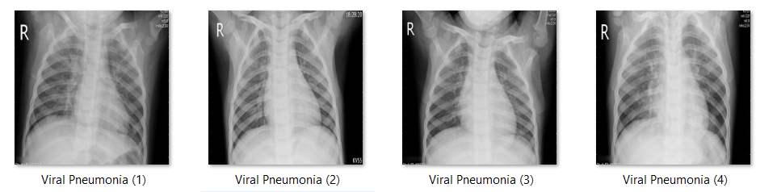
Experimental Database (Labeled)

Slide 26
Implementation
Import all the libraries.
Set all the constants.
Import data into tenserflow dataset object.
We will use image_dataset_from_directory api to load all images in tensorflow dataset: https://www.tensorflow.org/api_docs/python/tf/keras/preprocessing/image_dataset_from_directory
Then calling image_dataset_from_directory(main_directory, labels='inferred') will return a tf.data.Dataset that yields batches of images from the subdirectories class_a and class_b, together with labels 0 and 1 (0 corresponding to class_a and 1 corresponding to class_b).
Load train dataset.
Found 5144 files belonging to 3 classes.
Load test dataset.
Found 1288 files belonging to 3 classes.

Slide 27
This above code is using TensorFlow's image_dataset_from_directory method to load the test dataset from a directory. Here's a breakdown of the parameters:
/content/drive/MyDrive/Data/test: This is the path to the directory containing the test dataset.
seed=123: This sets a random seed for shuffling the dataset.
shuffle=True: This tells the method to shuffle the dataset before loading it.
image_size=(IMAGE_SIZE, IMAGE_SIZE): This sets the desired size of the images in the dataset. IMAGE_SIZE is a variable that should be defined earlier in the code.
batch_size=BATCH_SIZE: This sets the size of the batches to be used during training. BATCH_SIZE is another variable that should be defined earlier in the code.
After running this code, test_df will be a tf.data.Dataset object containing the test images and their corresponding labels. This can then be used for evaluating the model's performance on the test set.
The classes in the train and test datasets are 3 namely - ‘Covid19’, ‘Pnuemonia’, ‘Normal’

Slide 28
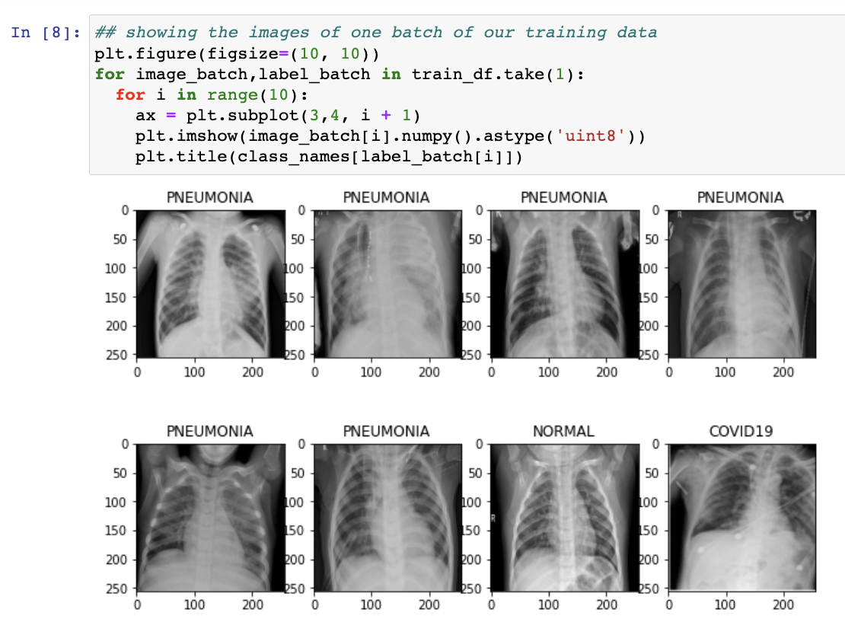
Visualise some of the images from our dataset

Slide 29
Creating a layer for resizing and normalization.
Before we feed our images to network, we should be resizing it to the desired size. Moreover, to improve model performance, we should normalize the image pixel value (keeping them in range 0 and 1 by dividing by 256). This should happen while training as well as inference. Hence we can add that as a layer in our Sequential Model.
You might be thinking why do we need to resize (256,256) image to again (256,256). You are right we don't need to but this will be useful when we are done with the training and start using the model for predictions. At that time someone can supply an image that is not (256,256) and this layer will resize it.
Data Augmentation.
Data Augmentation is needed when we have less data, this boosts the accuracy of our model by augmenting the data.
Building the model.

Slide 30
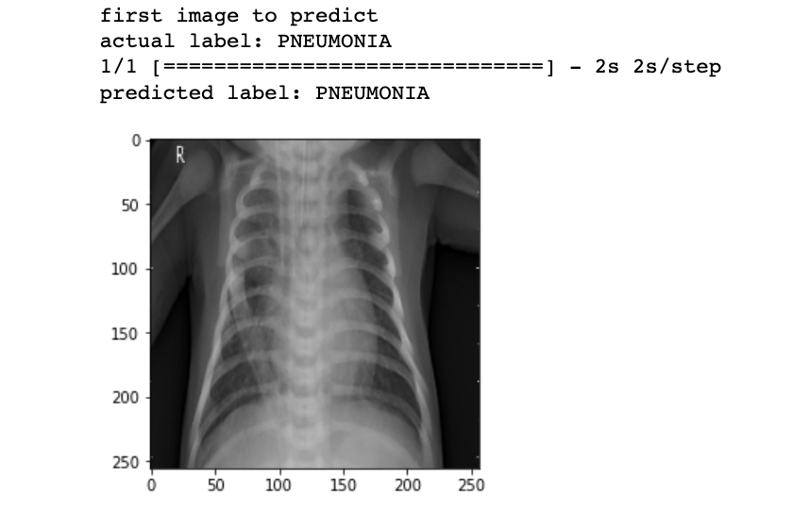
ResNet50 Model Architecture.
Create a base model for transfer learning using Resnet50 architecture.
Downloading data from https://storage.googleapis.com/tensorflow/keras-applications/resnet/resnet50_weights_tf_dim_ordering_tf_kernels_notop.h5
Run prediction on sample image.

Slide 31
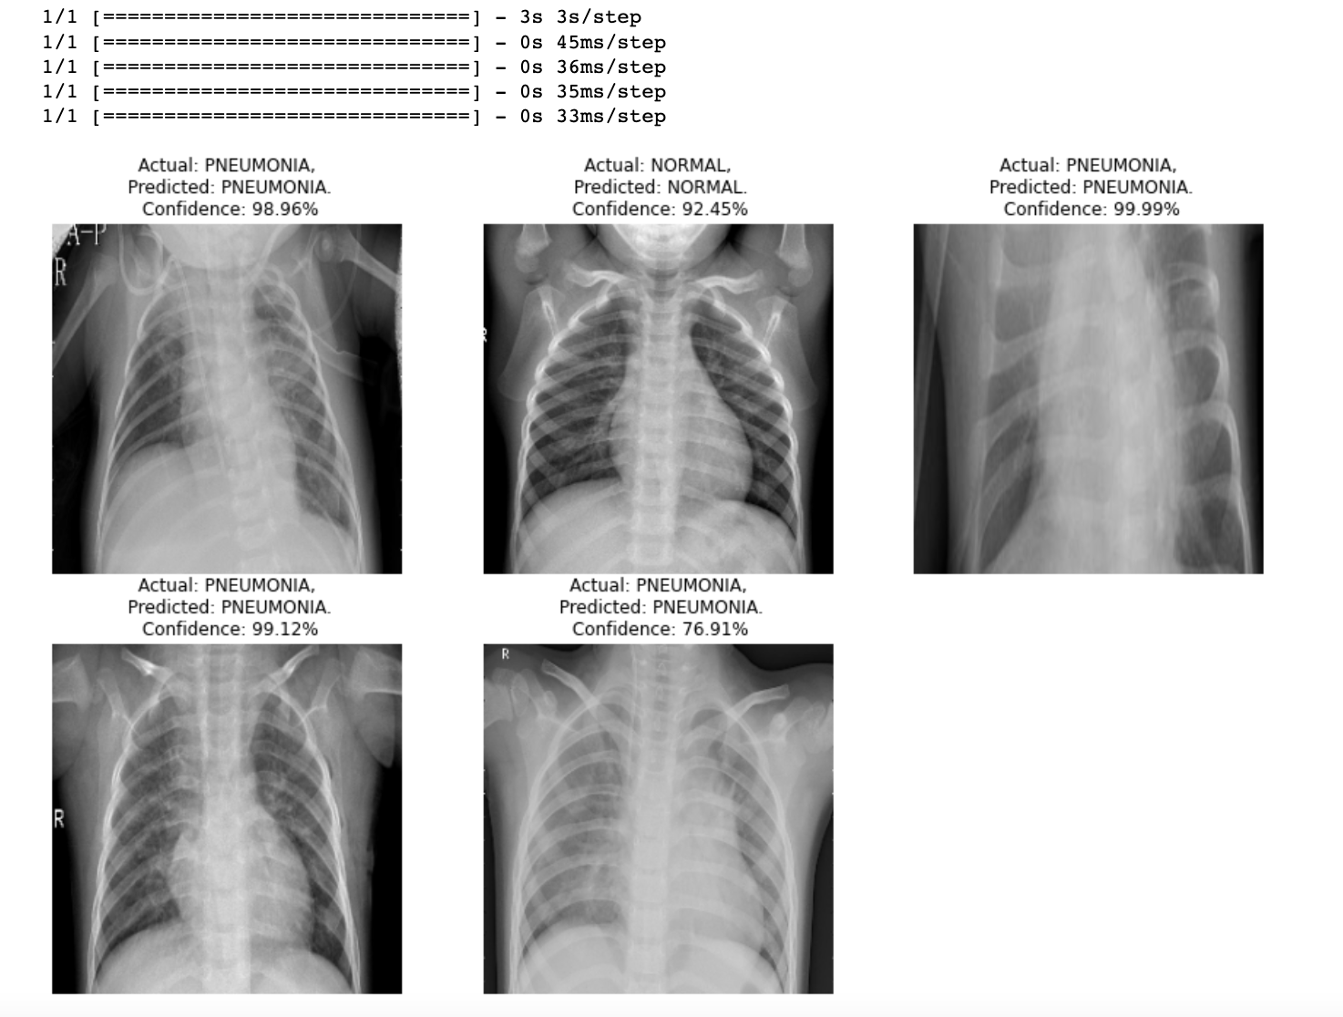
Write a function for inference.
Run inference on few sample images.

Slide 32
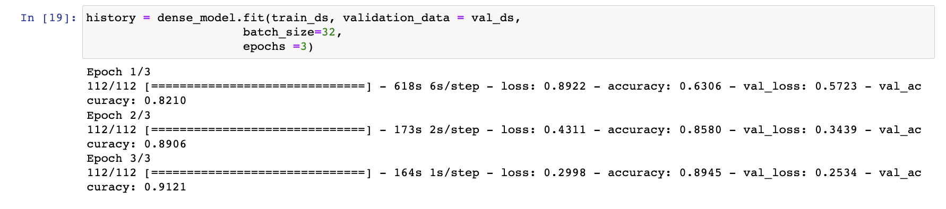
CheXnet Model Architecture.
Creating a base model for transfer learning using the CheXnet architecture
Downloading data from https://storage.googleapis.com/tensorflow/keras-applications/densenet/densenet121_weights_tf_dim_ordering_tf_kernels_notop.h5
Using 5 Convolution Blocks along with global average pooling, Dense layers, and then add a final softmax layer with 1 node for classification output.
Compile model

Slide 33
Bins Approach.
Define the directory where your images are stored
directory = r"/content/drive/MyDrive/Data/train"
Define the number of bins for your histogram
num_bins = 16
Define the size of your images
image_size = (128, 128)
Define a list to store your feature vectors
Features = []
Define a list to store your labels
labels = []
Loop through all the images in your directory
for filename in os.listdir(directory):
path=os.path.join(directory,filename)
for img in os.listdir(path):
print()

Slide 34
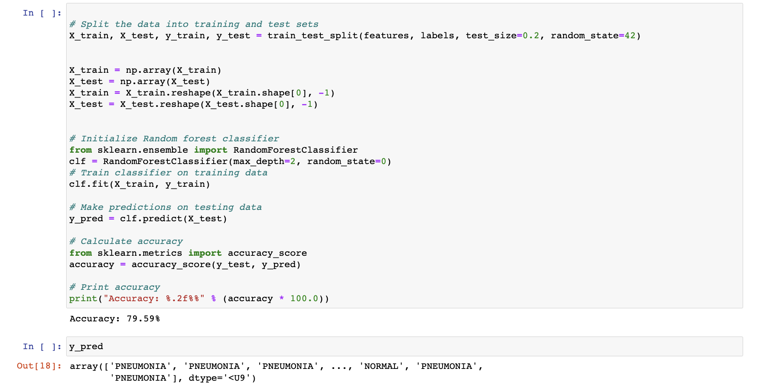

Slide 35
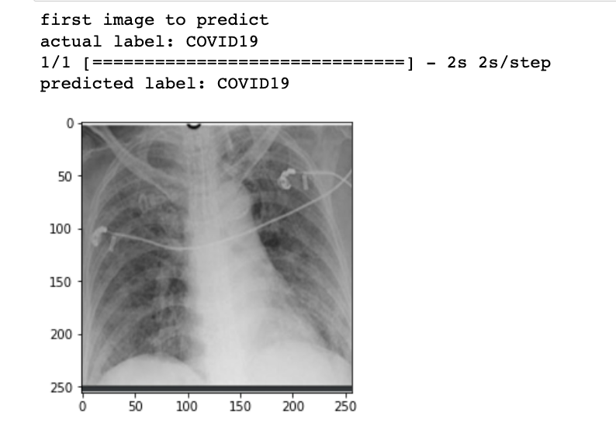
Run prediction on a simple image
Write a function for inference.
Run inference on a few sample images.

Slide 36
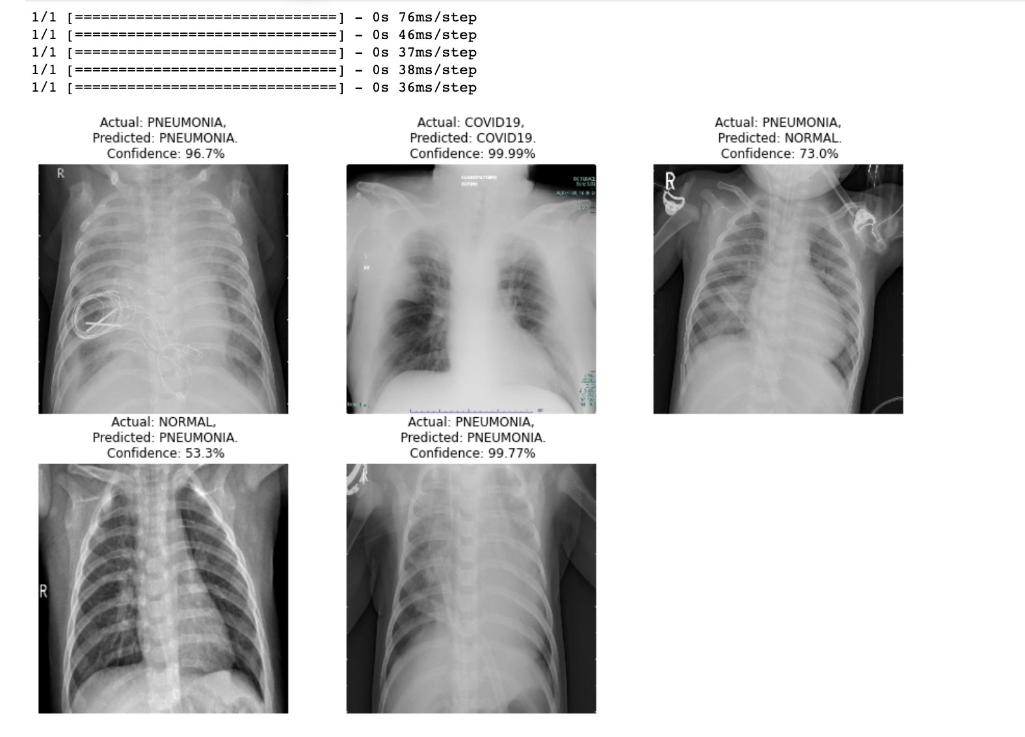
Run inference on a few sample images. (Output)

Slide 37
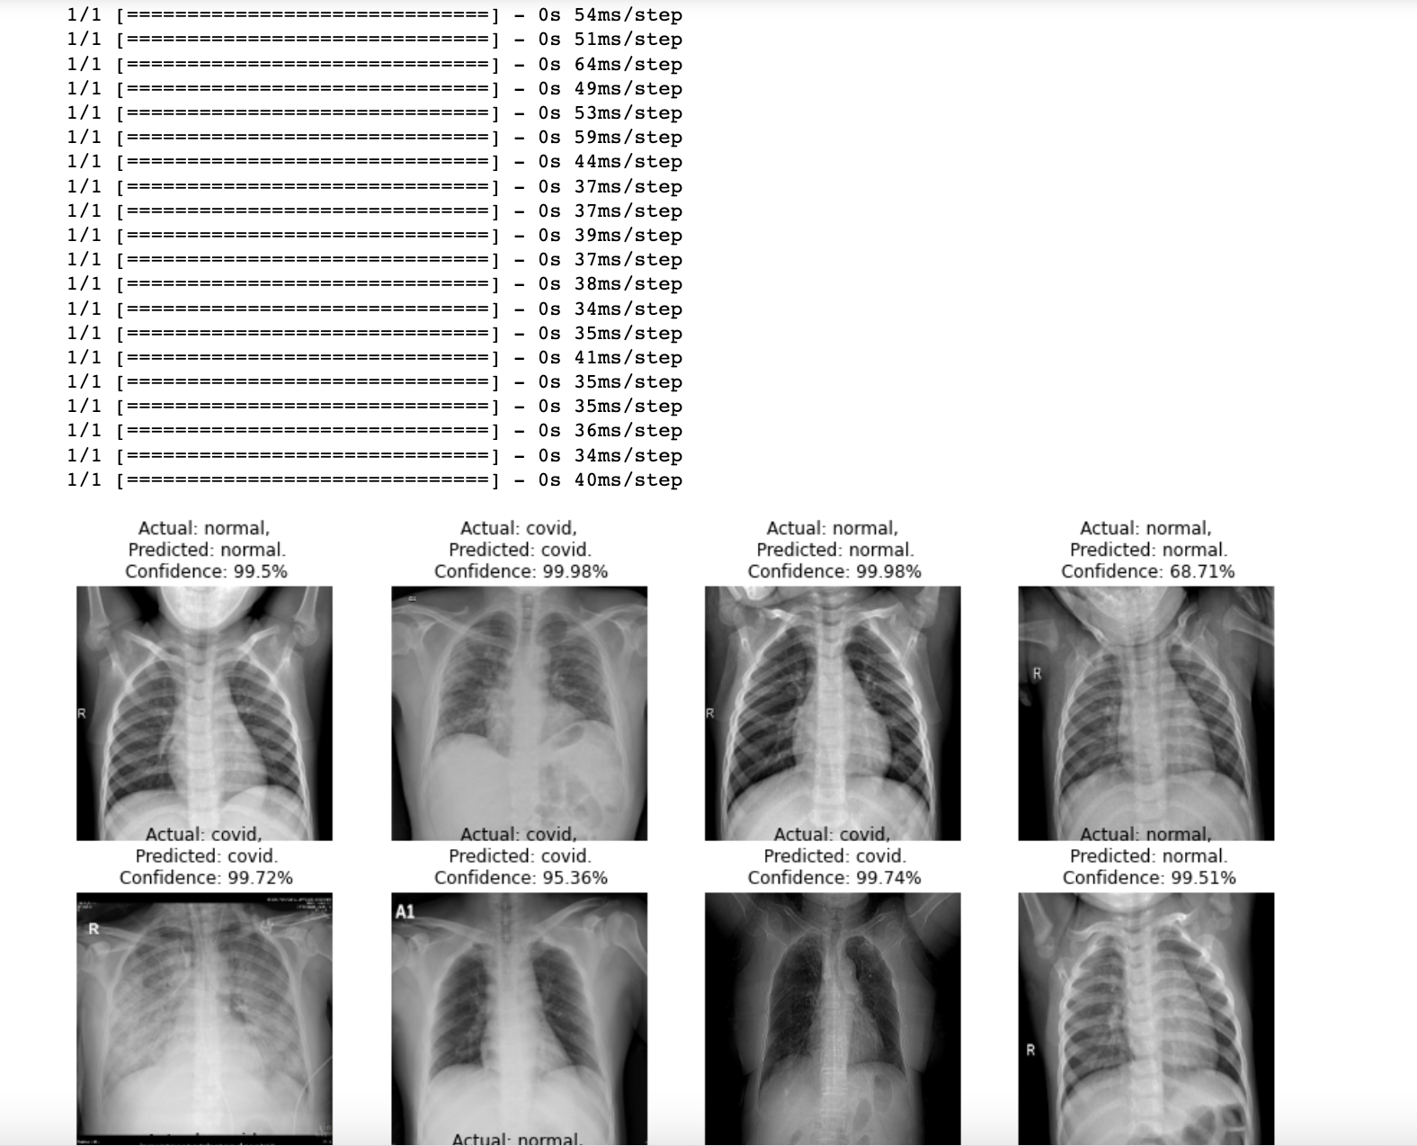
Prediction on new dataset samples.

Slide 38
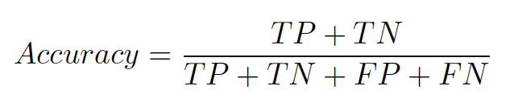
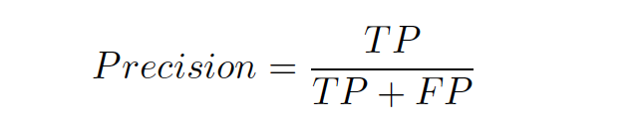
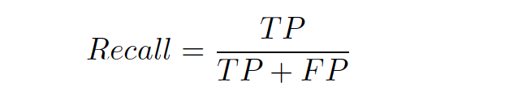
Performance Evaluation Parameters
Confusion matrix, which is 2x2 table showing four parameters, including the number of true positives, true negatives, false negatives and false positives.
Precision, Recall and Accuracy, which are three major performance metrics describing a predictive classification model.

Slide 39
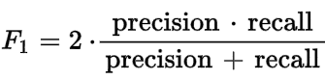
F1 measure is the harmonic mean between precision and recall.
ROC curve, which is a graphical summary of the overall performance of the model, showing the proportion of true positives and false positives at all possible values of probability cutoff.
Performance Evaluation Parameters

Slide 40
Results and Discussion
Approach parameters | CheXnet | Resnet50 | Bins with SVM | Bins with Random Forest | Bins with Logistic Regression
Accuracy | 93% | 96% | 79% | 82.21% | 71%
Precision | 92% | 96% | 79% | 82% | 72%
Recall | 93% | 96% | 79% | 82% | 71%
F1-score | 93% | 93% | 78% | 81% | 70%

Slide 41
We have accessed the parameters of Accuracy, Precision, Recall and F1-score and have correspondingly found the results of the output.
We can observe that Resnet50 works as considerably as good as CheXnet and bins approach, with accuracy scaling at 96% a result, inferring that Resnet50 works fairly well with our classification strategy, but slightly lesser than CheXnet.
Resnet50 is the best classifier for this approach with maximum accuracy which is significantly higher than the other methods.
CheXnet achiever high precision but it takes a long time to train the model.
Results obtained by implementing bins approach gives lesser accuracy compared to CheXnet and Resnet50.
Results and Discussion

Slide 42
Conclusion
In the course of our research, we have studied the various approaches contributing to the medical field of diseases, especially highlighting the repercussions of false detection of Covid-19 that can lead to more spread of the virus and early prediction of COVID-19 patients is vital to avoid spreading the sickness to totally different individuals.
during this study, we proposed a deep transfer learning-based approach the utilization of chest X-ray pictures obtained from COVID-19 patients, normal and virus infection for automatic detection of COVID-19 pneumonia.
Among all the possible ways to detect and diagnose the virus, we have chosen the image processing techniques to facilitate the doctors with a second opinion on the currently present testing mechanisms and also determine the severity of the patient.
We aim to create a system which is efficient and accurate.

Slide 43
References
Article ,
[1] Chaimae Ouchicha, Mohammed Meknassi,Ouafae Ammor, “CVDNet: A novel deep learning architecture for detection of coronavirus (Covid-19) from chest x-ray images” <https://www.ncbi.nlm.nih.gov/pmc/articles/PMC7472981/>
Journal paper,
[2] Karthika Rangrajan, Vinay P.Namboodiri,Chetan Aurora and 4 more. "COVID-19 detection using chest X-Ray." ResearchGate ( April 2020): 10.
[3] F. Ohata et al., "Automatic detection of COVID-19 infection using chest X-ray images through transfer learning," in IEEE/CAA Journal of Automatica Sinica, vol. 8, no. 1, pp. 239-248, January 2021, doi: 10.1109/JAS.2020.1003393.

Slide 44
[4] Kanne, Little, Chung, Brett, Ketai, 2020 J.P. Kanne, B.P. Little, J.H. Chung, M.E. Brett, L.H. Keto Essentials for radiologists on COVID-19: an update - radiology scientific expert panel Radiology (2020), 10.1148/radiol.2020200527.
[5] Sohaib Asif, Yi Wenhui, Hou Jin, Yi Tao, Si Jinhai. Classification of COVID-19 from Chest X-ray images using Deep Convolutional Neural Networks doi:https://doi.org/10.1101/2020.05.01.20088211.
[6] Luca Brunesea, Francesco Mercaldoa, Alfonso Reginelli, Antonella Santone. Explainable Deep Learning for Pulmonary Disease and Coronavirus COVID-19 Detection from X-rays.
[7]Feng Shi ,Jun Wang, Jun Shi, Ziyan Wu, Qian Wang, Zhenyu Tang, Kelei He, Yinghuan Shi,Dinggang Shen. Review of Artificial Intelligence Techniques in Imaging Data Acquisition, Segmentation and Diagnosis for COVID-19.
[8]Hrishikesh Telang and Kavita Sonawane. Effective performance of bins approach for classification of malaria parasite using machine learning. In 2020 IEEE 5th International Conference on Computing Communication and Automation (ICCCA), pages 427–432. IEEE, 2020.
References

Slide 45
Publication
We have written an IEEE paper “Performance Comparison of Bins Approach With Deep Learning Models For Image Based Detection And Classification Of Covid-19” for publishing at a conference and it is under review.

Slide 46
Thank You.

